Slide 1
Chapter 12: Boolean Algebra
12.1 Boolean Functions
Boolean algebra is a branch of mathematics that deals with operations on logical values with binary variables. The Boolean variables are represented as binary numbers to represent truths: 1 = true and 0 = false. Elementary algebra deals with numerical operations whereas Boolean algebra deals with logical operations.
The basic operations of Boolean algebra are conjunction, disjunction, and negation. These Boolean operations are expressed with the corresponding binary operators AND, and OR and the unary operator NOT, collectively referred to as Boolean operators.
FREE: For Complete Playlist: https://www.youtube.com/c/FahadHussaintutorial/playlists
For Code, Slide and Books: https://fahadhussaincs.blogspot.com/

Slide 2
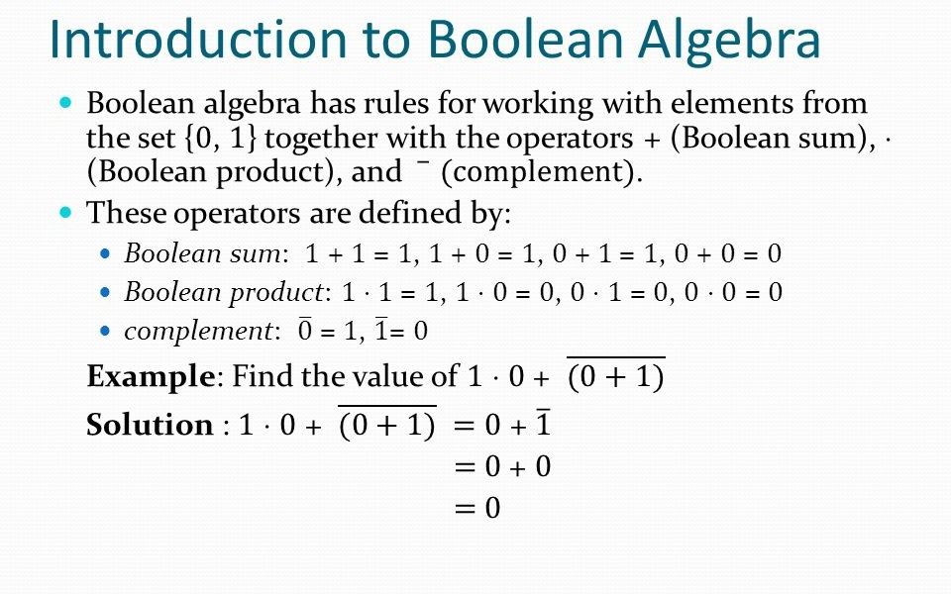
FREE: For Complete Playlist: https://www.youtube.com/c/FahadHussaintutorial/playlists
For Code, Slide and Books: https://fahadhussaincs.blogspot.com/

Slide 3
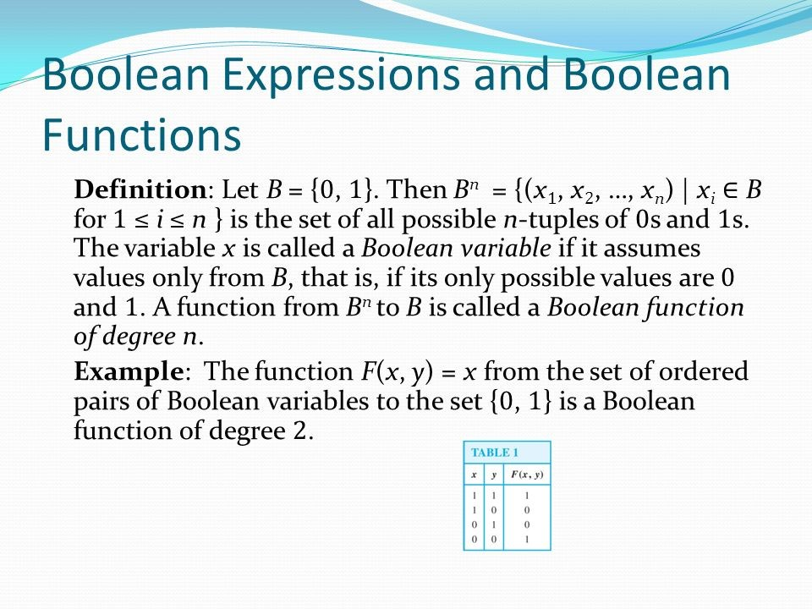

Slide 4
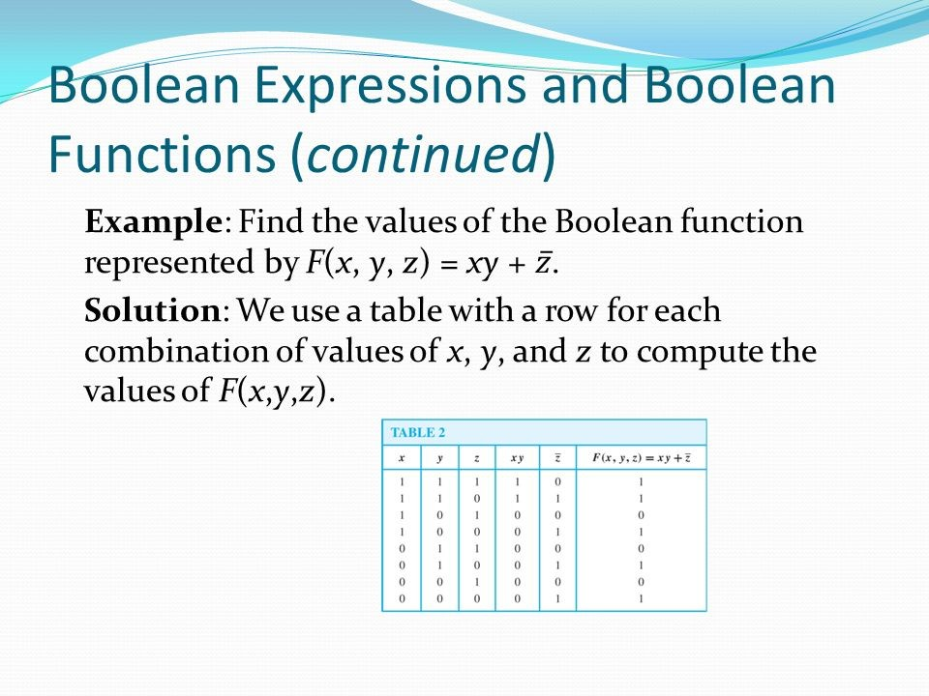
FREE: For Complete Playlist: https://www.youtube.com/c/FahadHussaintutorial/playlists
For Code, Slide and Books: https://fahadhussaincs.blogspot.com/

Slide 5
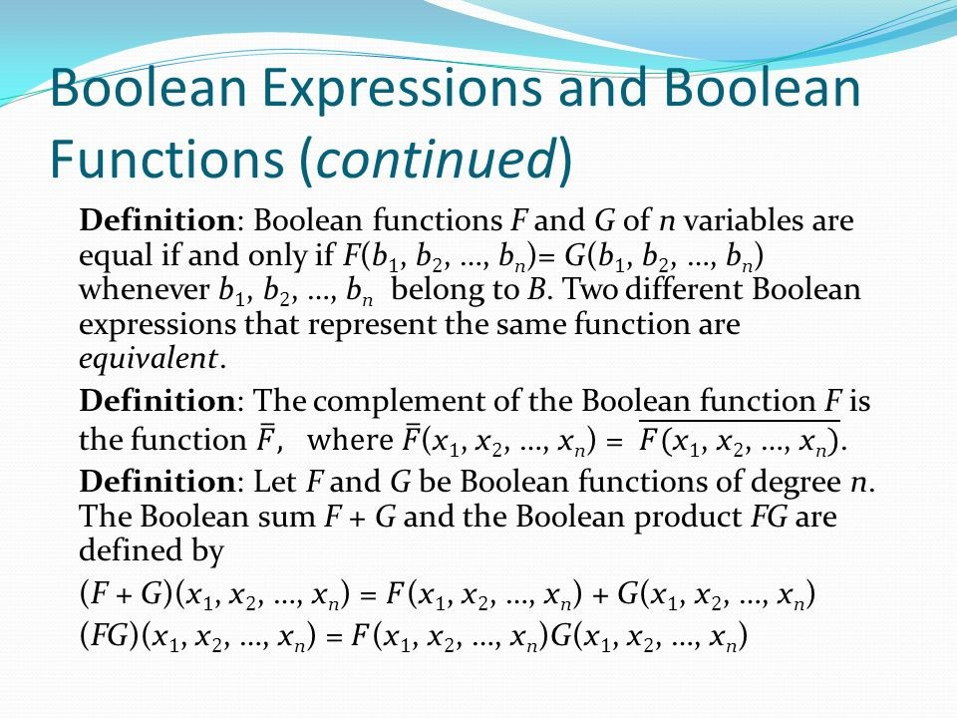

Slide 6
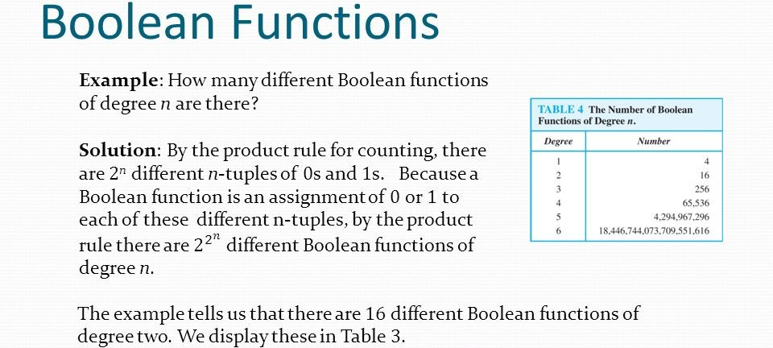
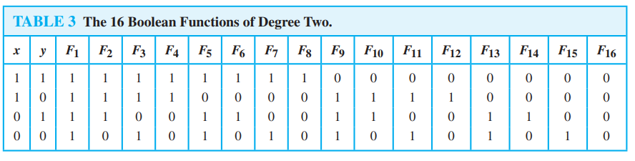

Slide 7
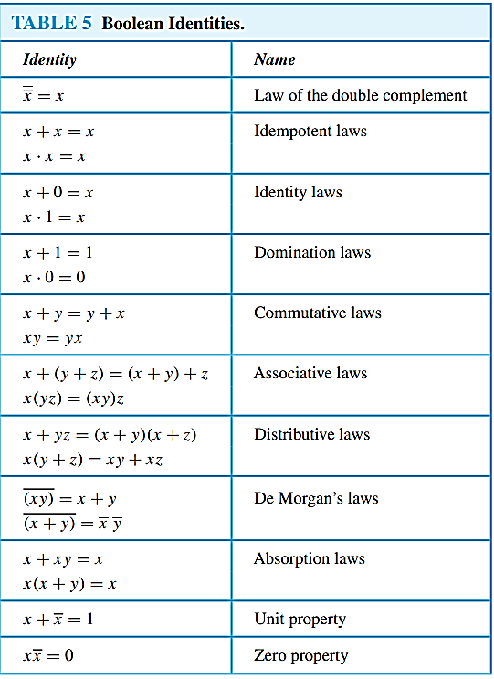
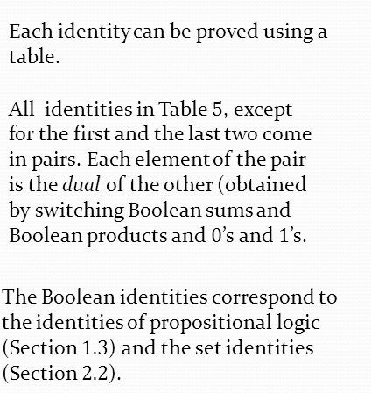
Identities of Boolean Algebra

Slide 8
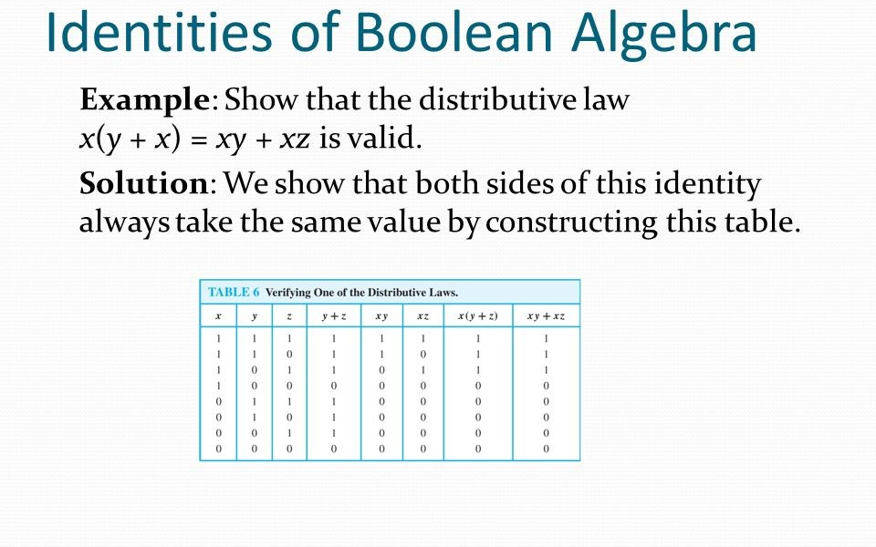
FREE: For Complete Playlist: https://www.youtube.com/c/FahadHussaintutorial/playlists
For Code, Slide and Books: https://fahadhussaincs.blogspot.com/

Slide 9
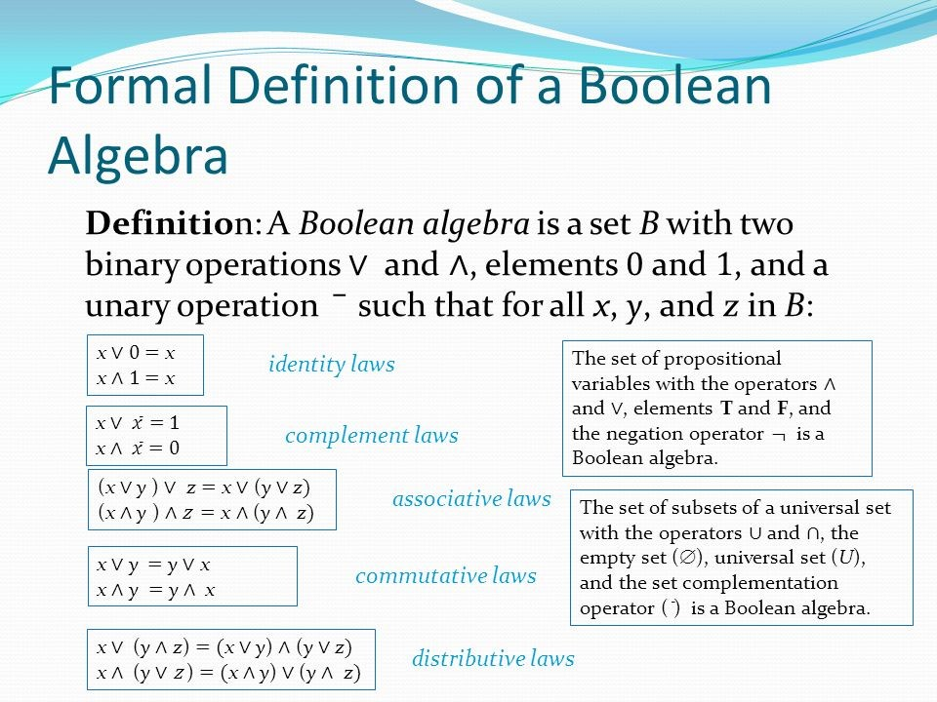

Slide 10
12.2
Representing
Boolean Functions

Slide 11
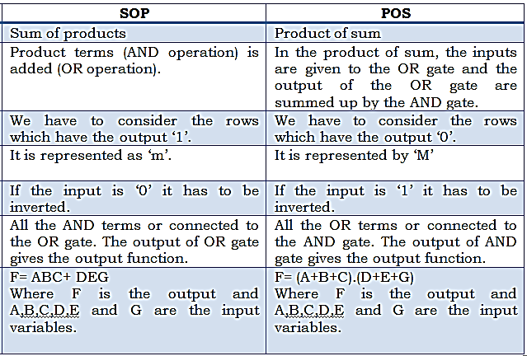

Slide 12
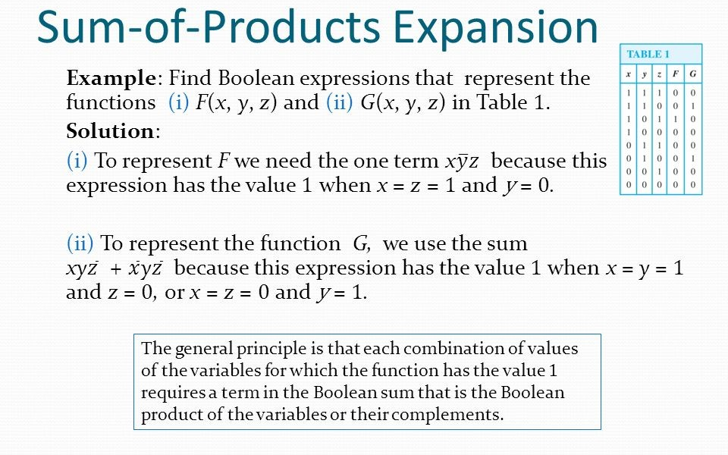

Slide 13
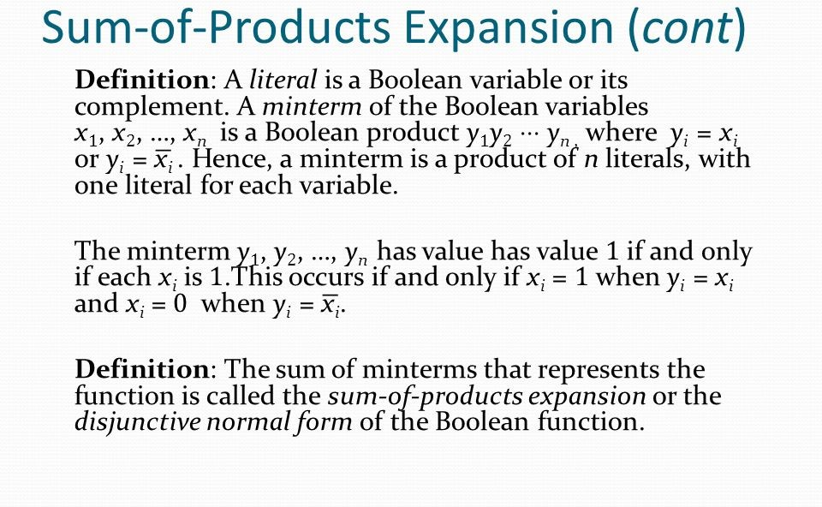

Slide 15
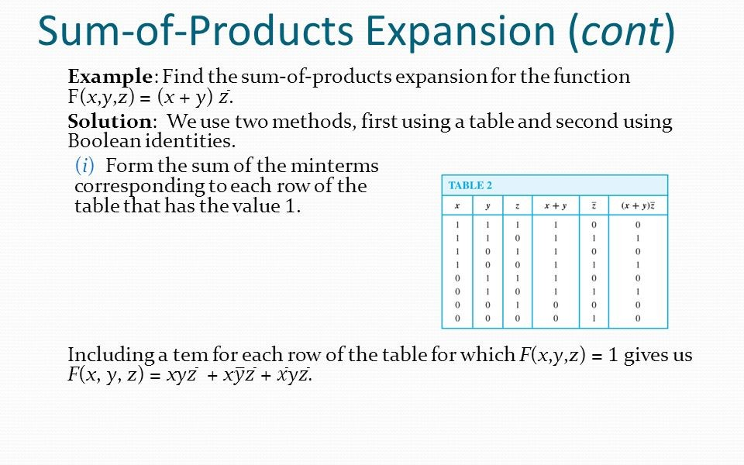
FREE: For Complete Playlist: https://www.youtube.com/c/FahadHussaintutorial/playlists
For Code, Slide and Books: https://fahadhussaincs.blogspot.com/

Slide 16
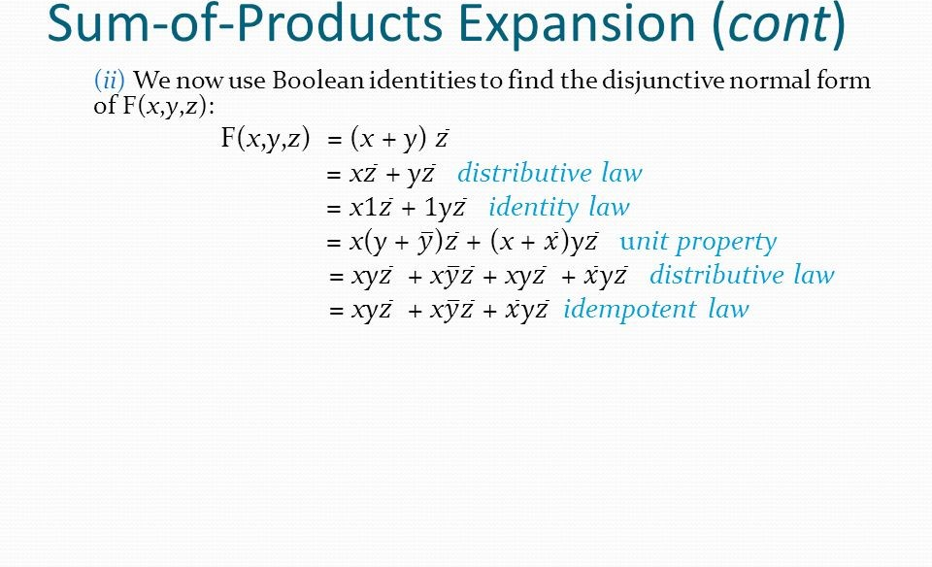
FREE: For Complete Playlist: https://www.youtube.com/c/FahadHussaintutorial/playlists
For Code, Slide and Books: https://fahadhussaincs.blogspot.com/

Slide 17
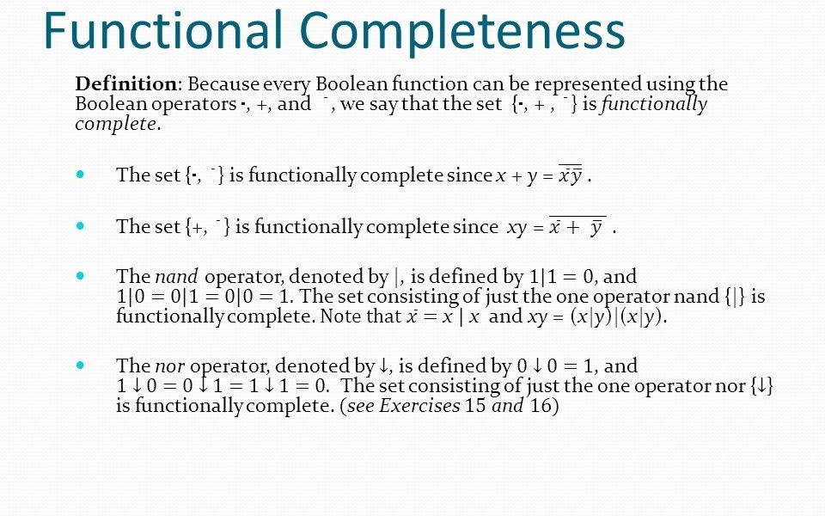
FREE: For Complete Playlist: https://www.youtube.com/c/FahadHussaintutorial/playlists
For Code, Slide and Books: https://fahadhussaincs.blogspot.com/

Slide 18
FREE: For Complete Playlist: https://www.youtube.com/c/FahadHussaintutorial/playlists
For Code, Slide and Books: https://fahadhussaincs.blogspot.com/

Slide 19
12.3 Logic Gates
Logic gates are the basic building blocks of any digital system. It is an electronic circuit having one or more than one input and only one output. The relationship between the input and the output is based on a certain logic.
A logic gate is an idealized or physical device that performs a Boolean function, a logical operation performed on one or more binary inputs that produces a single binary output.

Slide 20
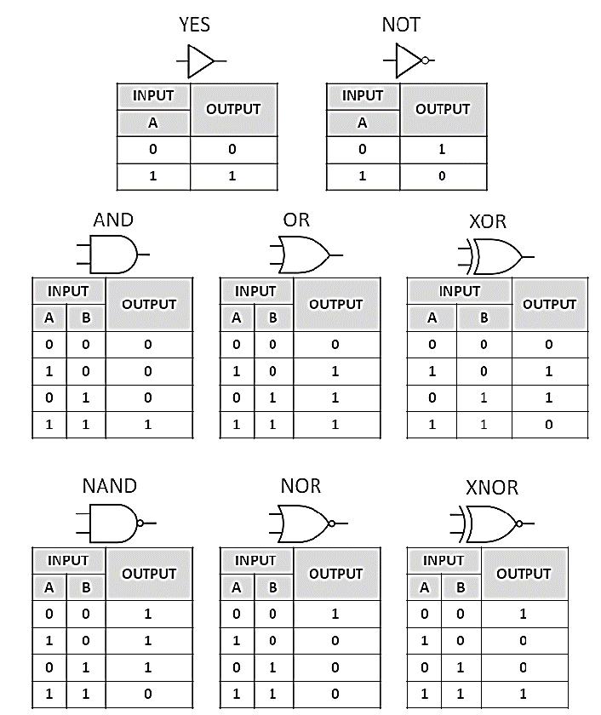

Slide 21
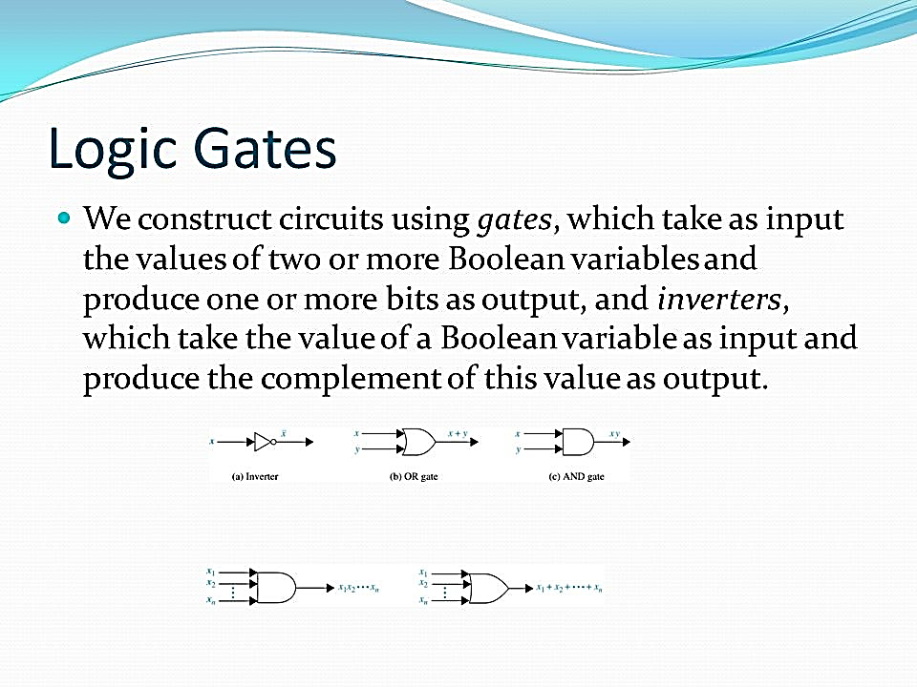

Slide 22
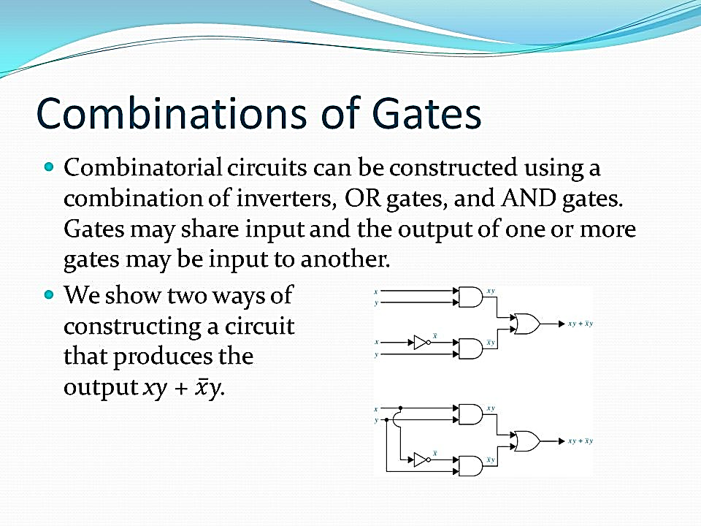
FREE: For Complete Playlist: https://www.youtube.com/c/FahadHussaintutorial/playlists
For Code, Slide and Books: https://fahadhussaincs.blogspot.com/

Slide 23
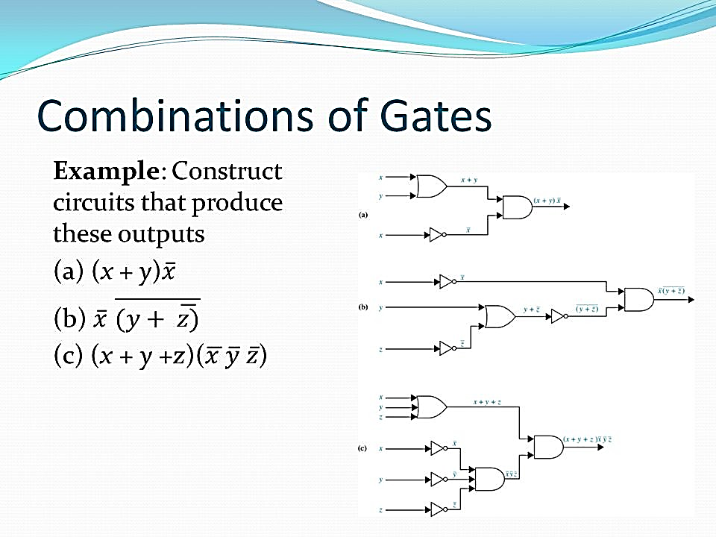

Slide 24
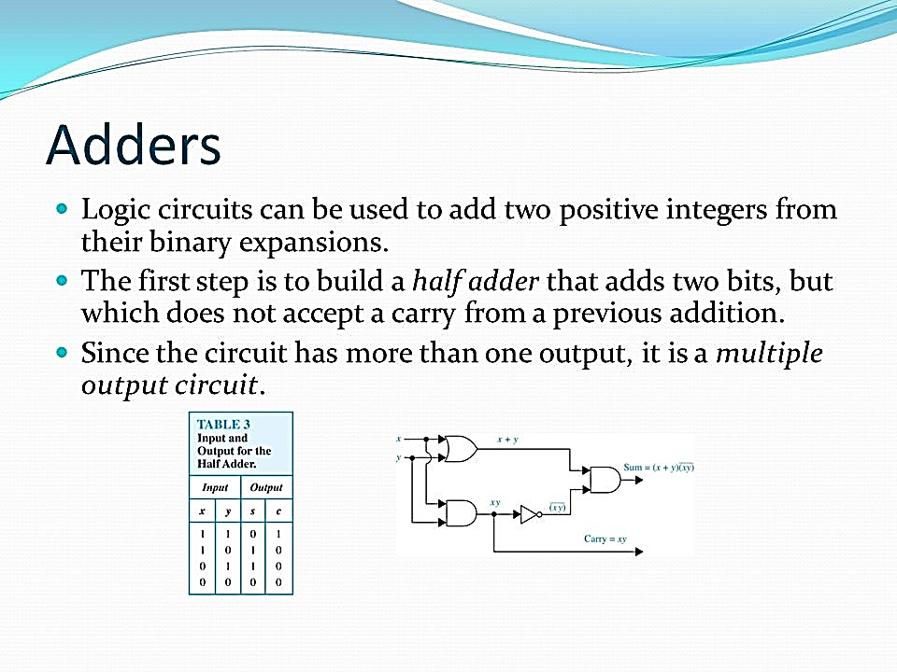
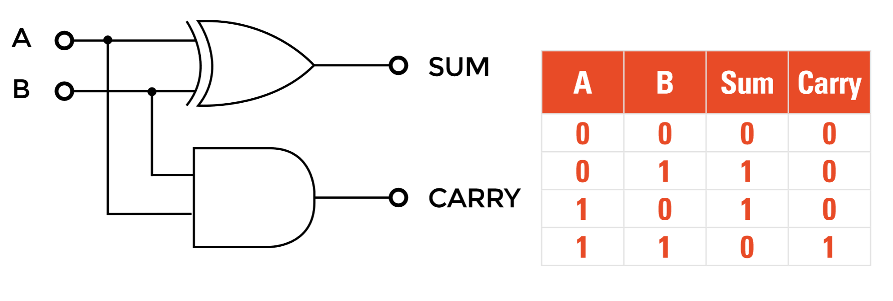
Half Adder

Slide 25
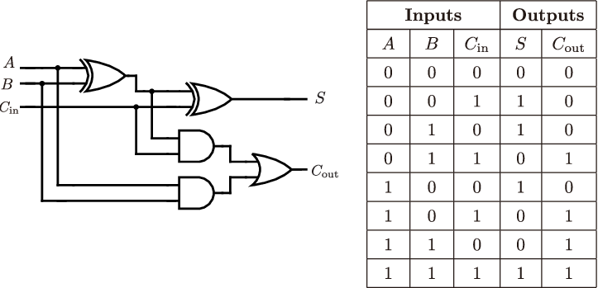
Full Adder
FREE: For Complete Playlist: https://www.youtube.com/c/FahadHussaintutorial/playlists
For Code, Slide and Books: https://fahadhussaincs.blogspot.com/

Slide 26
12.4
Minimization of Circuits

Slide 27
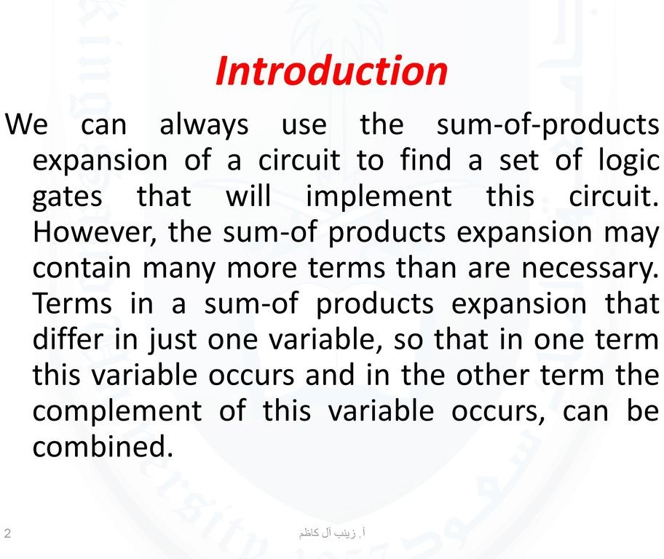

Slide 28
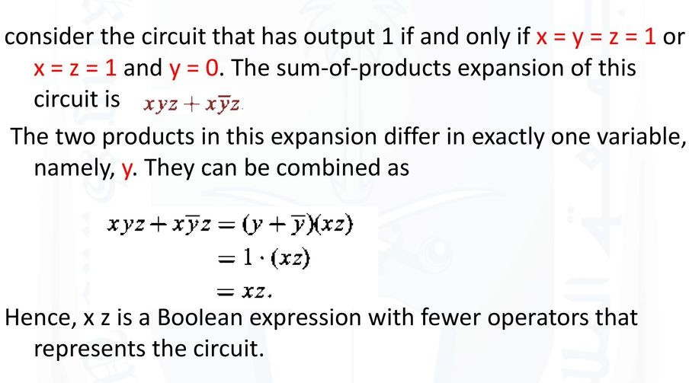

Slide 29
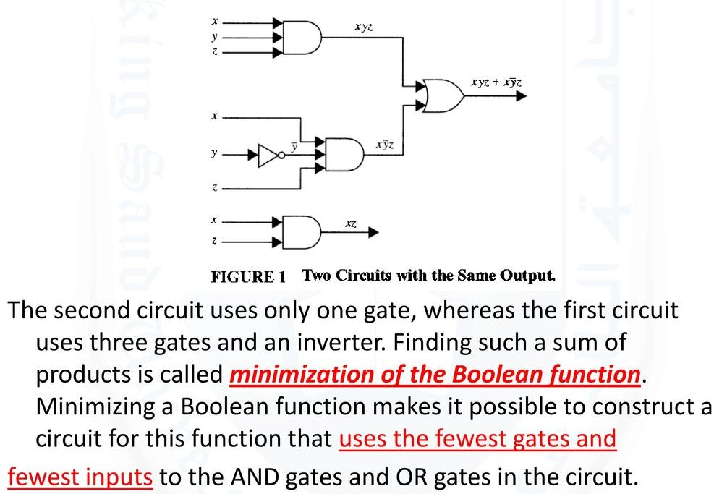

Slide 30
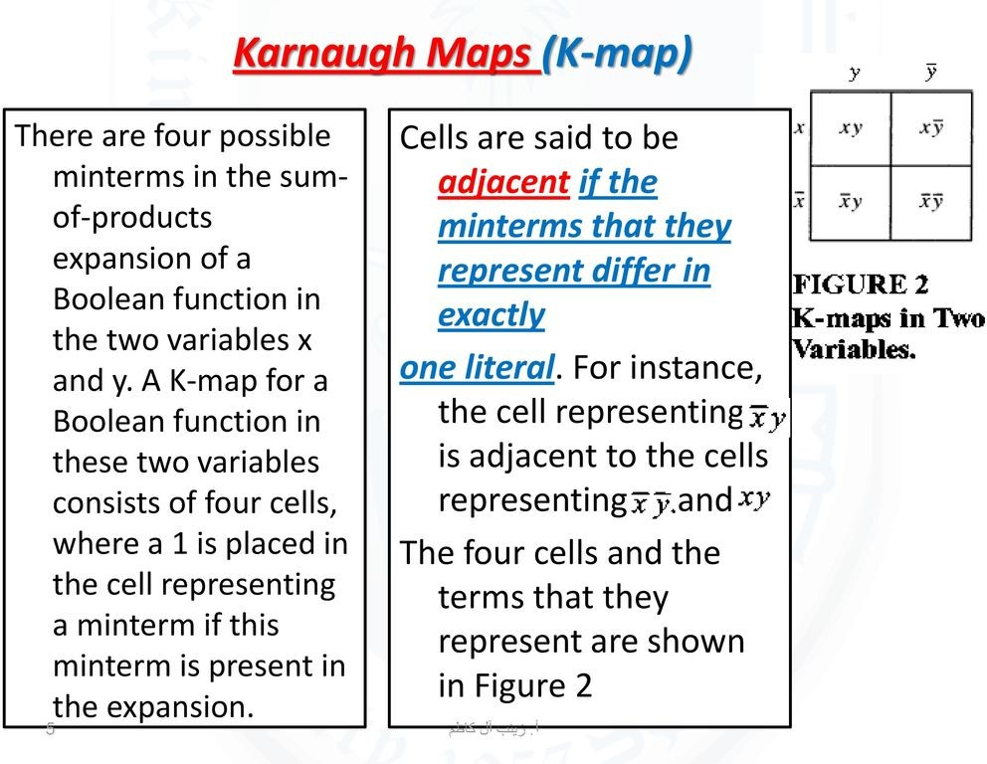

Slide 31
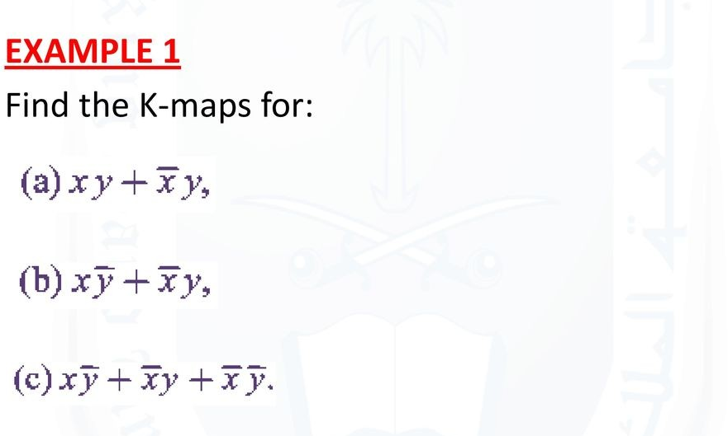

Slide 32
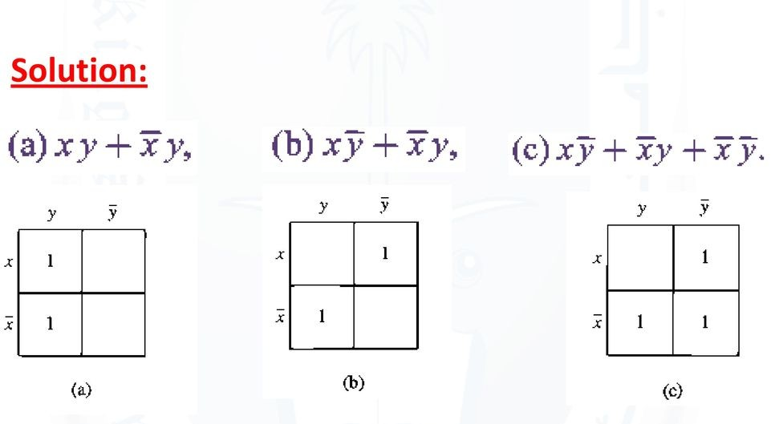

Slide 33
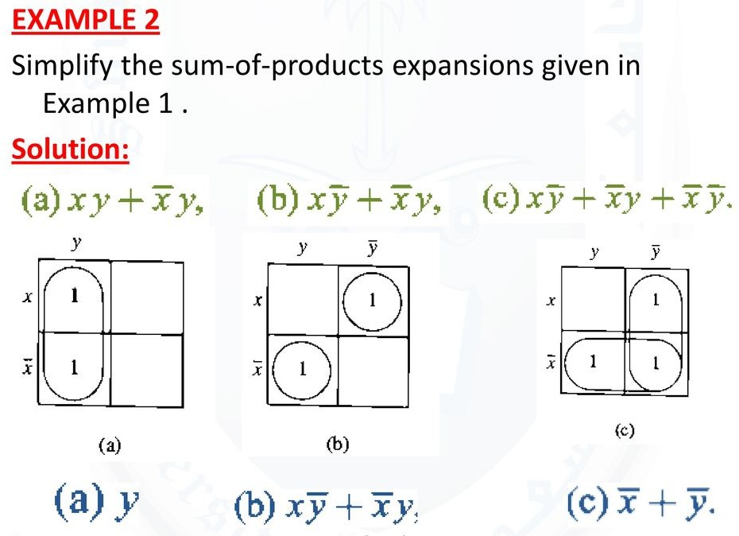

Slide 34
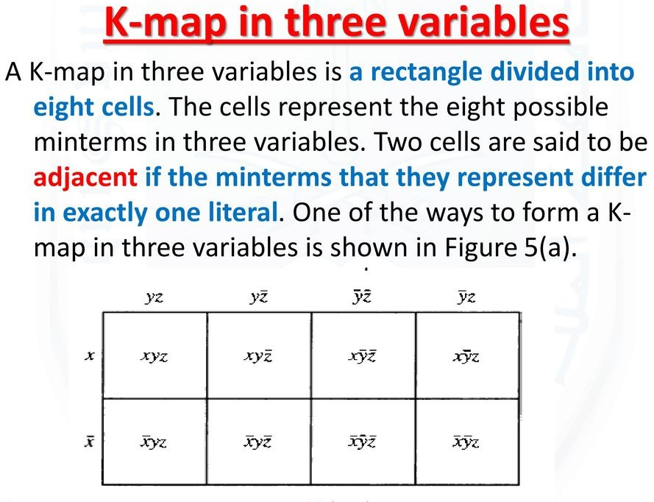

Slide 35
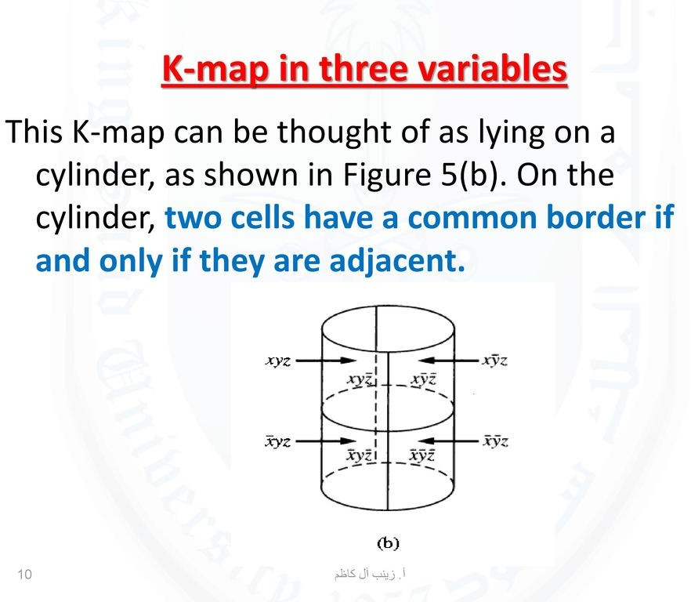

Slide 36
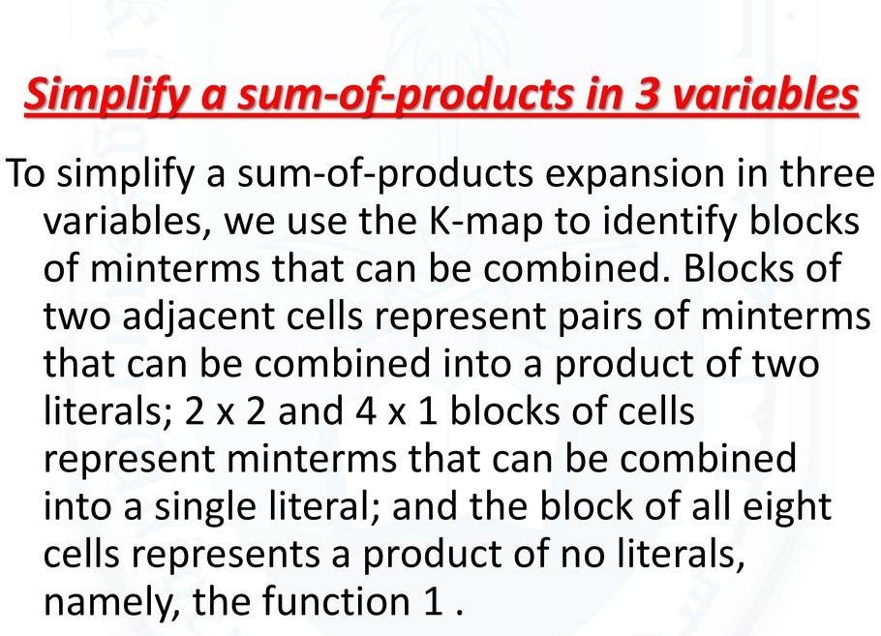

Slide 37
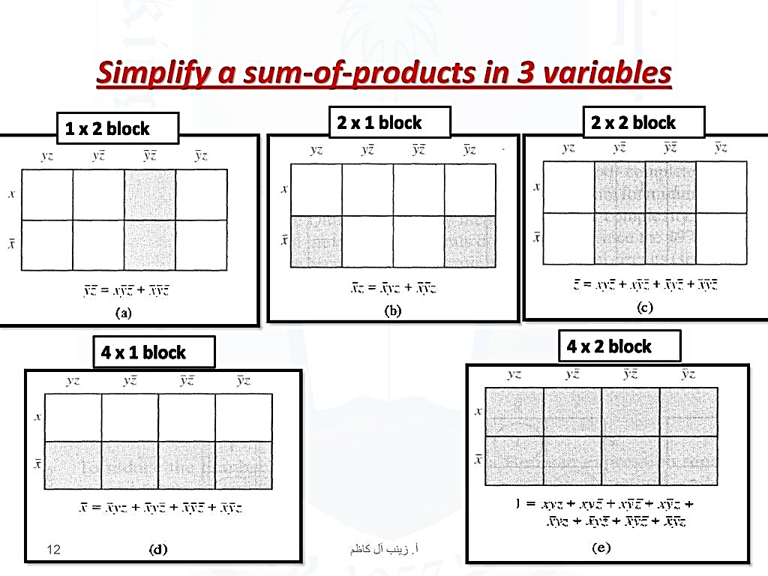

Slide 38
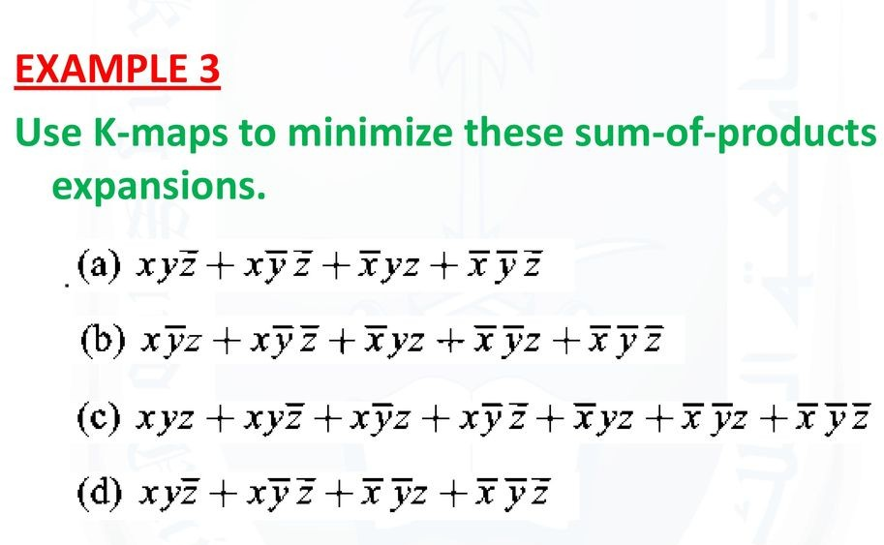

Slide 39
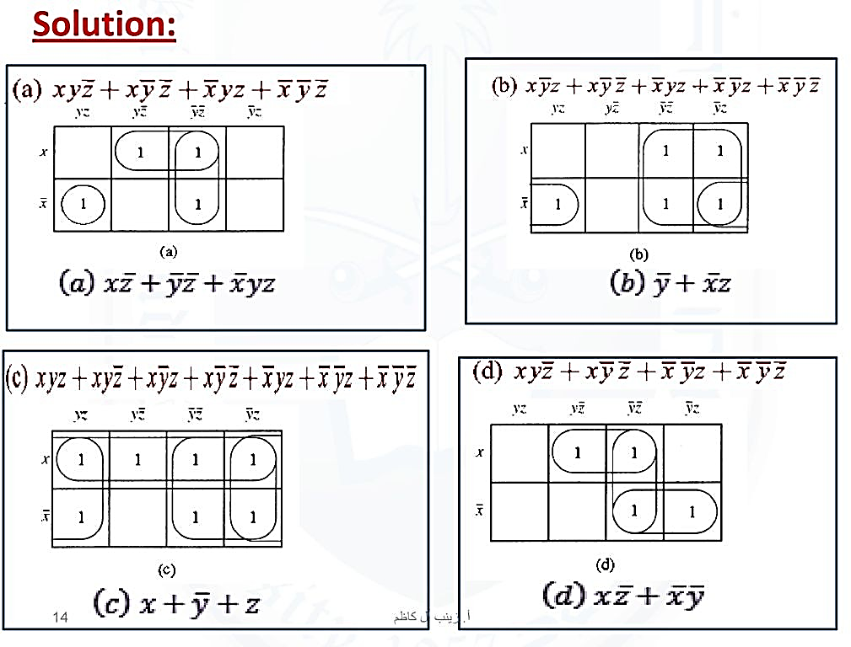

Slide 40
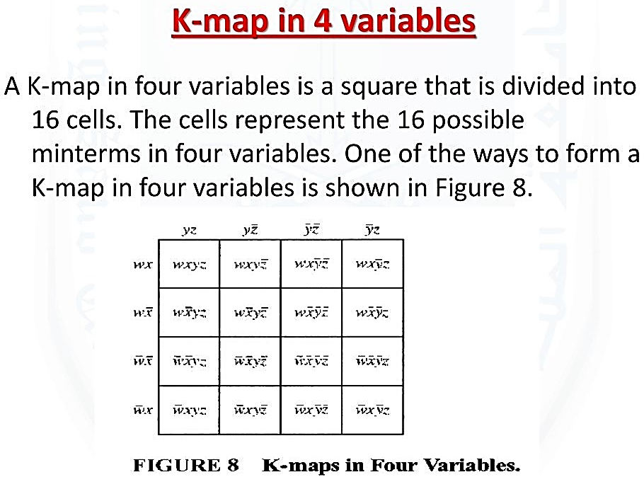

Slide 41
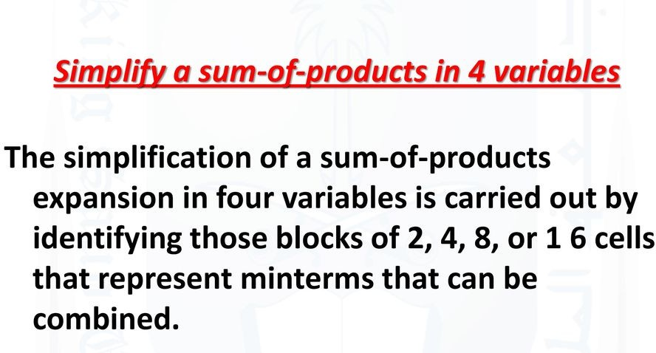

Slide 42
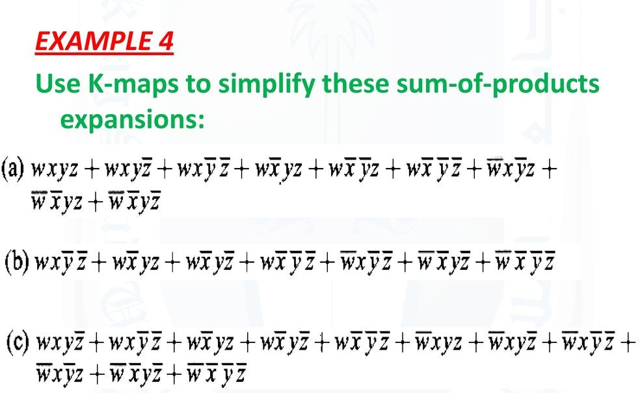

Slide 43
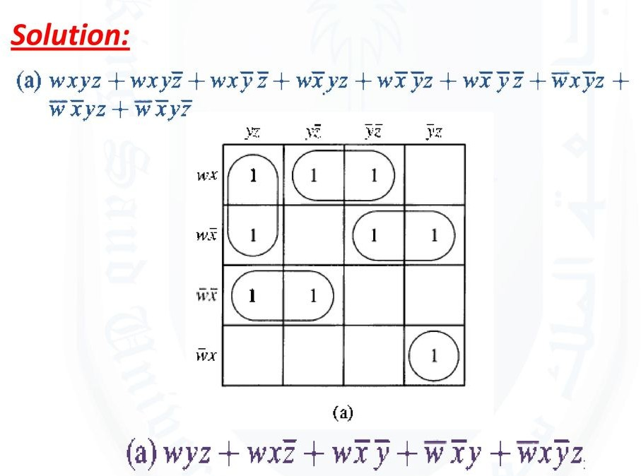

Slide 44
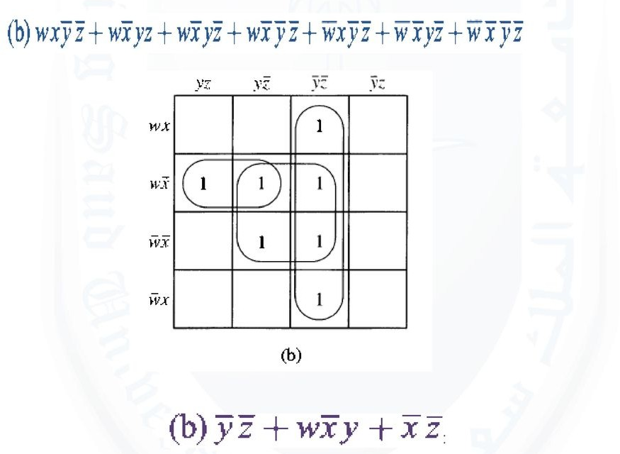

Slide 45
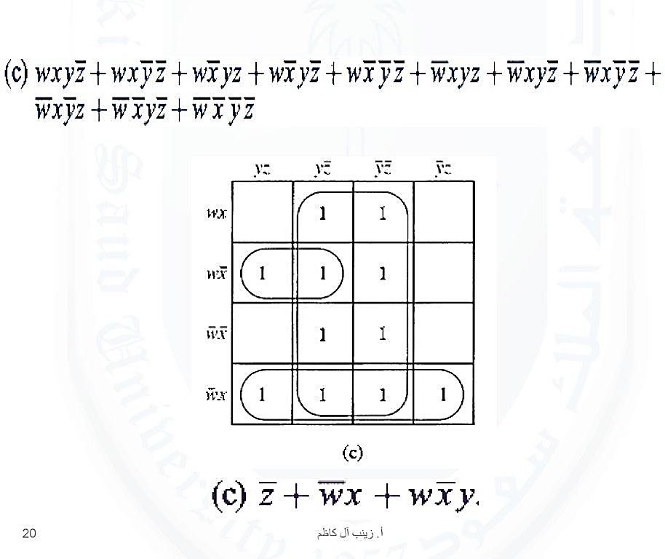

Slide 46
Don’t Care (X) Conditions in K-Maps
For SOP and POS

Slide 47
Don’t Care (X) Conditions in K-Maps
For SOP and POS
The "Don't care" condition says that we can use the blank cells of a K-map to make a group of the variables. To make a group of cells, we can use the "don't care" cells as either 0 or 1, and if required, we can also ignore that cell. We mainly use the "don't care" cell to make a large group of cells.

Slide 48
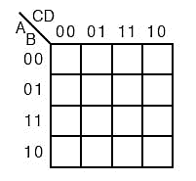
Minimise the following function in SOP minimal form using K-Maps:
f = m(0,2,3,6,7,12,13,14) + d(1,4,11,15)
Explanation:
The SOP K-map for the given expression is:

Slide 49
Minimise the following function in SOP minimal form using K-Maps:
f = M(5,8,9,10) + d(1,4,11,15)
Explanation:
The POS K-map for the given expression is:

Slide 50
Minimise the following function in SOP minimal form using K-Maps:
f = m(1, 5, 6, 11, 12, 13, 14) + d(4)
Explanation:
The SOP K-map for the given expression is:
f = BC' + BCD' + A'C'D + AB'CD
Minimise the following function in SOP minimal form using K-Maps:
F(A, B, C, D) = m(1, 2, 6, 7, 8, 13, 14, 15) + d(0, 3, 5, 12)
Explanation:
The SOP K-map for the given expression is:
f = AC'D' + A'D + A'C + AB

Slide 51
Minimise the following function in POS minimal form using K-Maps:
F(A, B, C, D) = M(6, 7, 8, 9) + d(12, 13, 14, 15)
The POS K-map for the given expression is:
Therefore, POS minimal is,
F = (A'+ C)(B' + C')

Slide 52
The Quine–McCluskey
Method

Slide 53
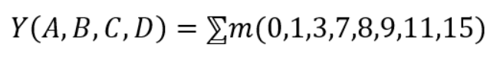
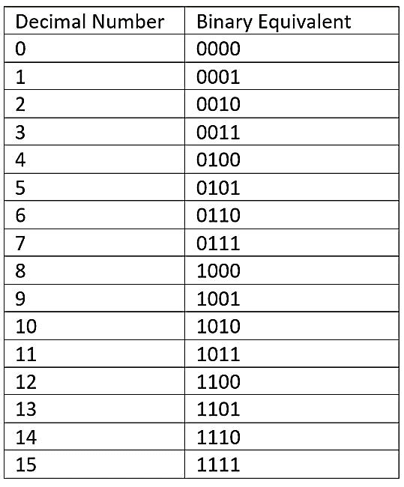
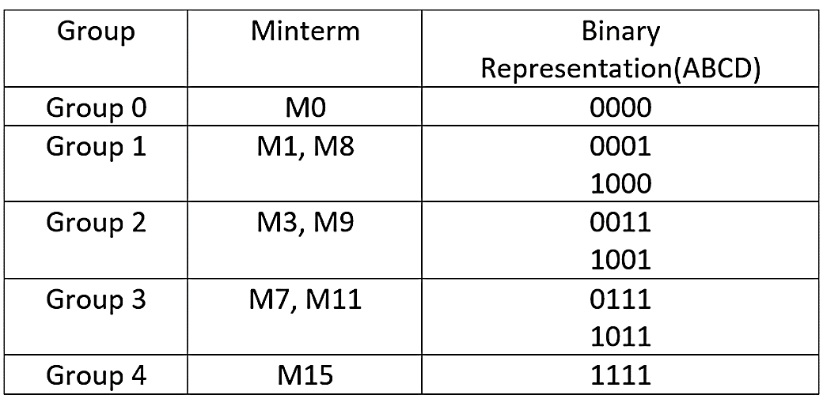

Slide 54
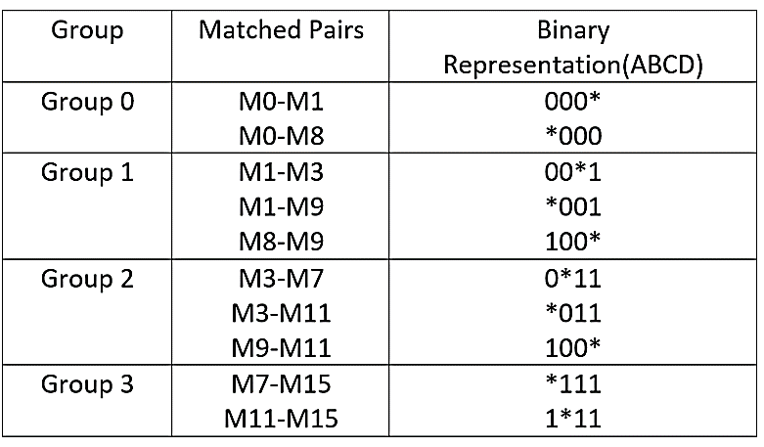

Slide 55
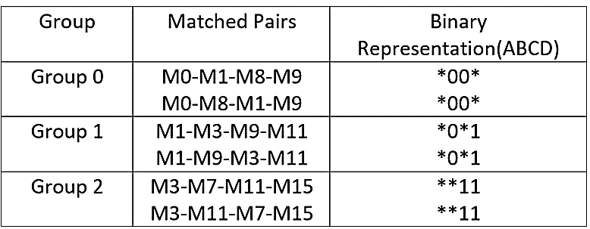

Slide 56
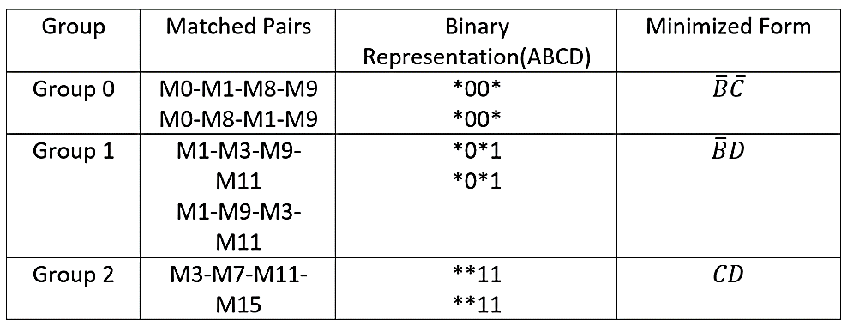

Slide 57
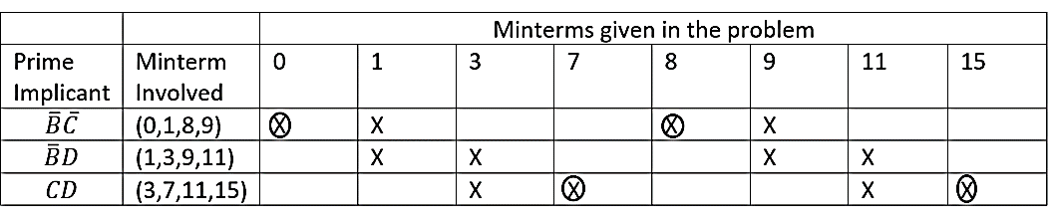

Slide 58

From the prime implicants, we can check the minterms involved. Like for the first one the minterms involved are (0,1,8,9), and we will put across if it appears in the minterm given in the problem. Then we need to identify by putting a circle if that minterm is appearing only once.
So the minterm involved in the second row (1,3,9,11) are not essential prime implicants. Since each of them has already appeared in the first or third row. So finally the minimized expression can be given as
Hence we have seen, how to obtain the minimized expression by using the Quine McCluskey method. The same procedure can be checked for a problem involving 5 or 6 variables.

